Slide 1


Twitter Sentiment and Bitcoin
This Photo by Unknown Author is licensed under CC BY-SA
An Intra and Inter-day Market Analysis
Jessica Fogerty
DATS 6103 Section 10
This Photo by Unknown Author is licensed under CC BY

Slide 2
pROJECT iNTRODUCTION
Bitcoin is an extremely volatile cryptocurrency.
Identifying key market drivers is important.
The purpose of this project: To determine whether a correlation between Twitter sentiment and Bitcoin price exists.
I also examined the correlations between volume of tweets and Bitcoin Price
I examined both cases at the intra and inter-day levels
To determine if either sentiment and/or volume could be isolated as short or long-term market drivers

Slide 3
pROJECT OVERVIEW
Twitter Search Words: Bitcoin, BTC, $BTC
Live Stream Date Range: 10/23/18 16:00 – 11/2/18 15:00
Objectives:
Discuss Tweet cleaning techniques and sentiment analysis.
Determine if a correlation between Tweet sentiment and Bitcoin Price exists at the intra day and inter-day levels.
Determine if a correlation between Tweet volume and Bitcoin Price exists at the intra day and inter-day levels.
Examine the number of Tweets in each language and from each user defined location.

Slide 4
Data Sources
www.sfm.library.gwu.edu
Twitter Data
www.coindesk.com
Bitcoin Data

Slide 5
Learning oUTCOMES
Learned how to clean a large dataset (4.5 million data points, 350MB)
Pandas
Numpy
Learned how to work with Twitter data and prepare it for sentiment analysis.
Text Blob
NLTK
Learned how to plot data in various ways.
Matplotlib
Seaborn
Plotly
Word Cloud
Re
String

Slide 6
Code Overview

Slide 7
Correlation Between Polarity and Bitcoin Price Per hour for each day

Slide 8
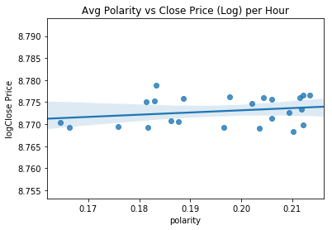
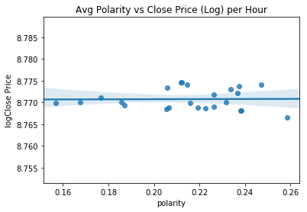
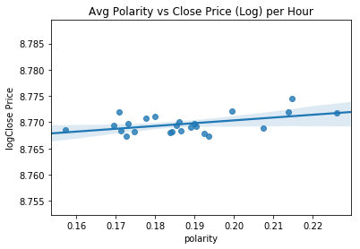
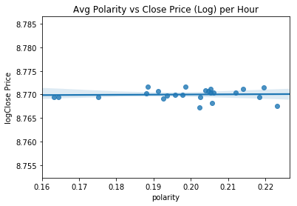

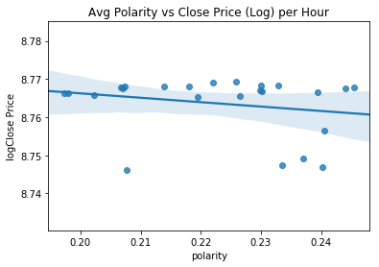
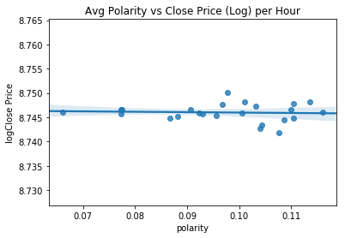
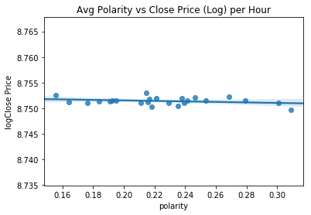
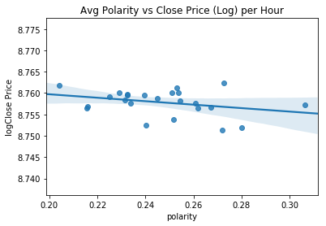

Slide 9
Correlation Between volume and Bitcoin Price Per hour for each day

Slide 10
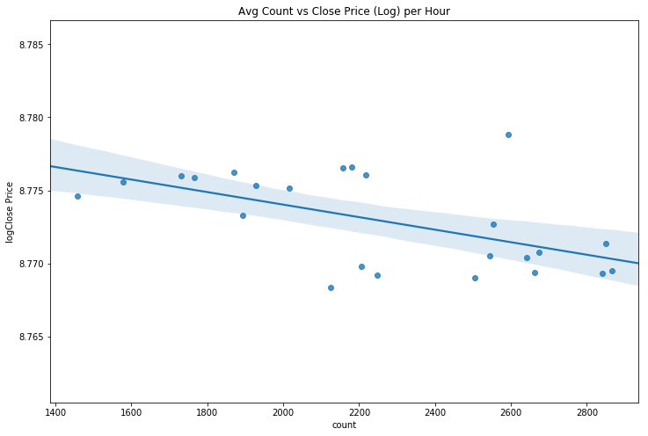
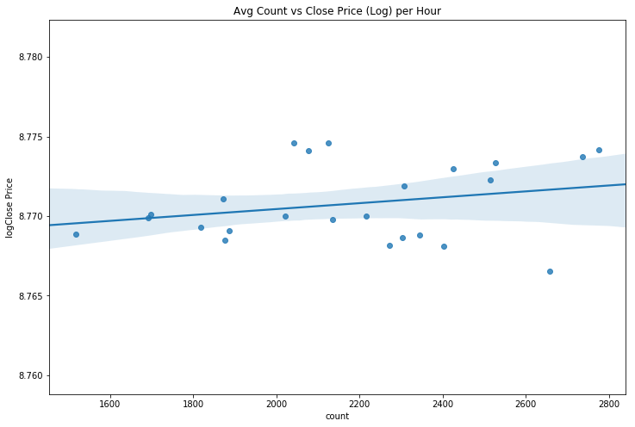
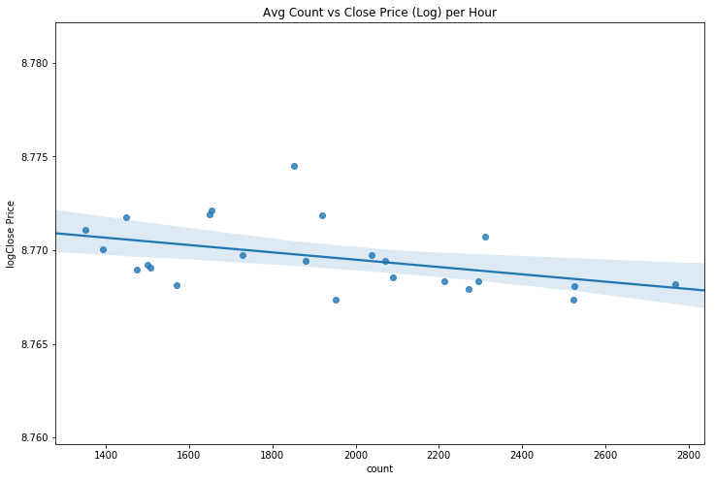
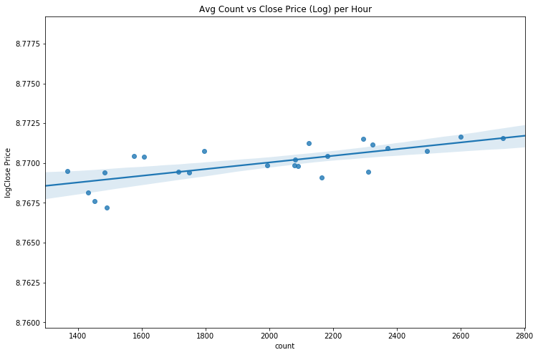
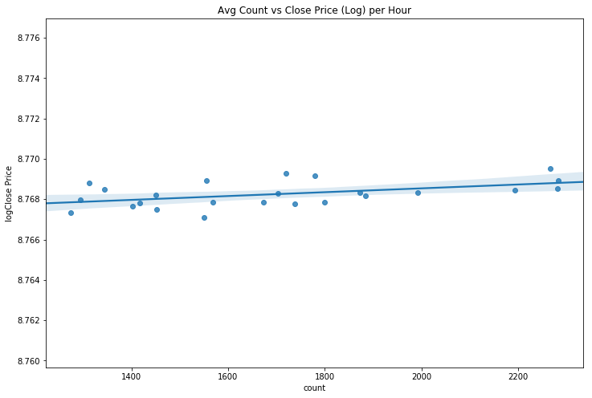
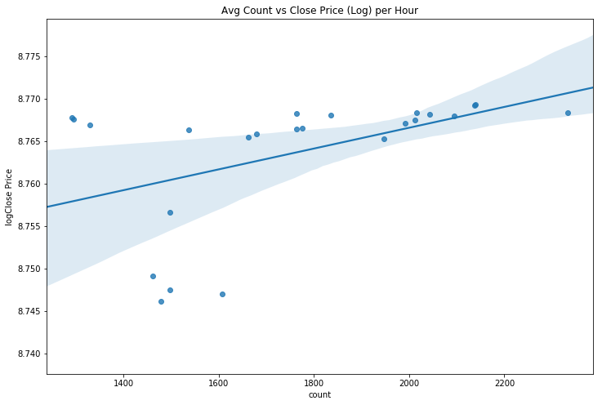
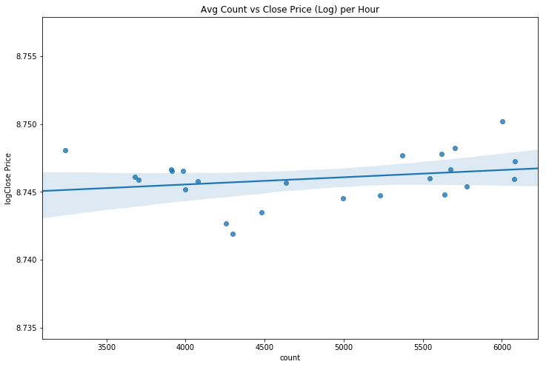
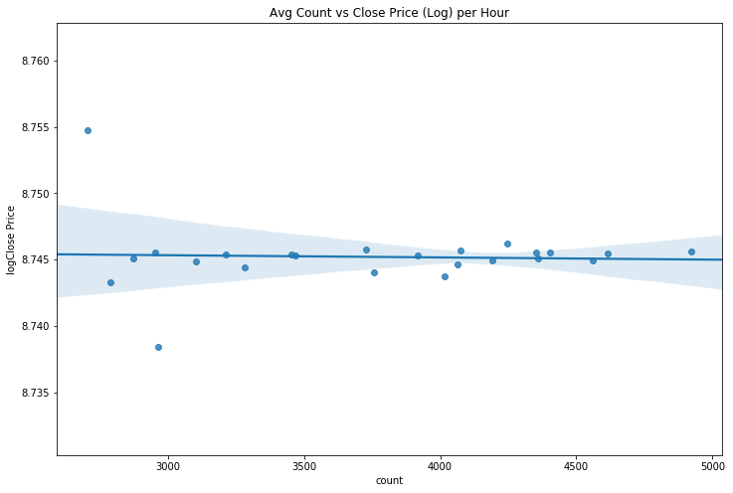
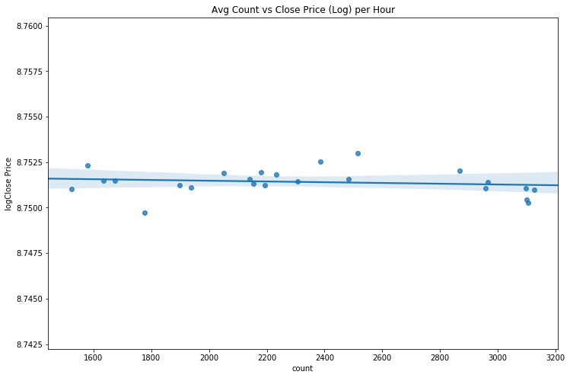

Slide 11
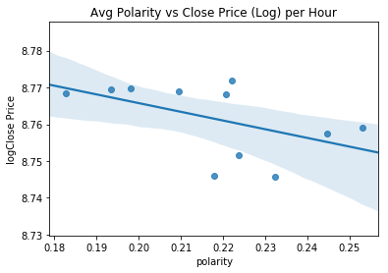
Correlation Between Polarity and Bitcoin Price Per day

Slide 12
Correlation Between Tweet Volume and Bitcoin Price Per day

Slide 13
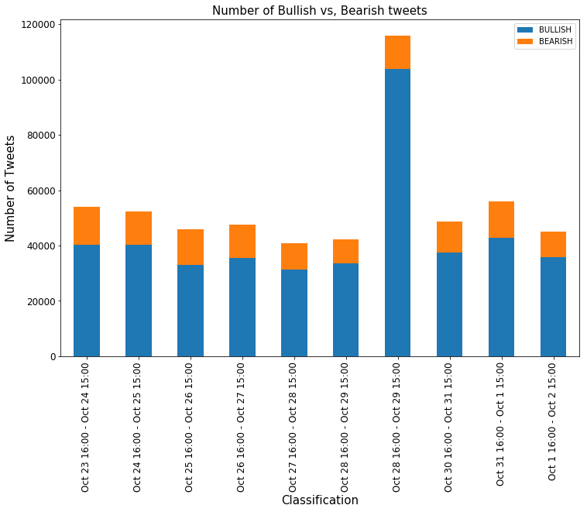
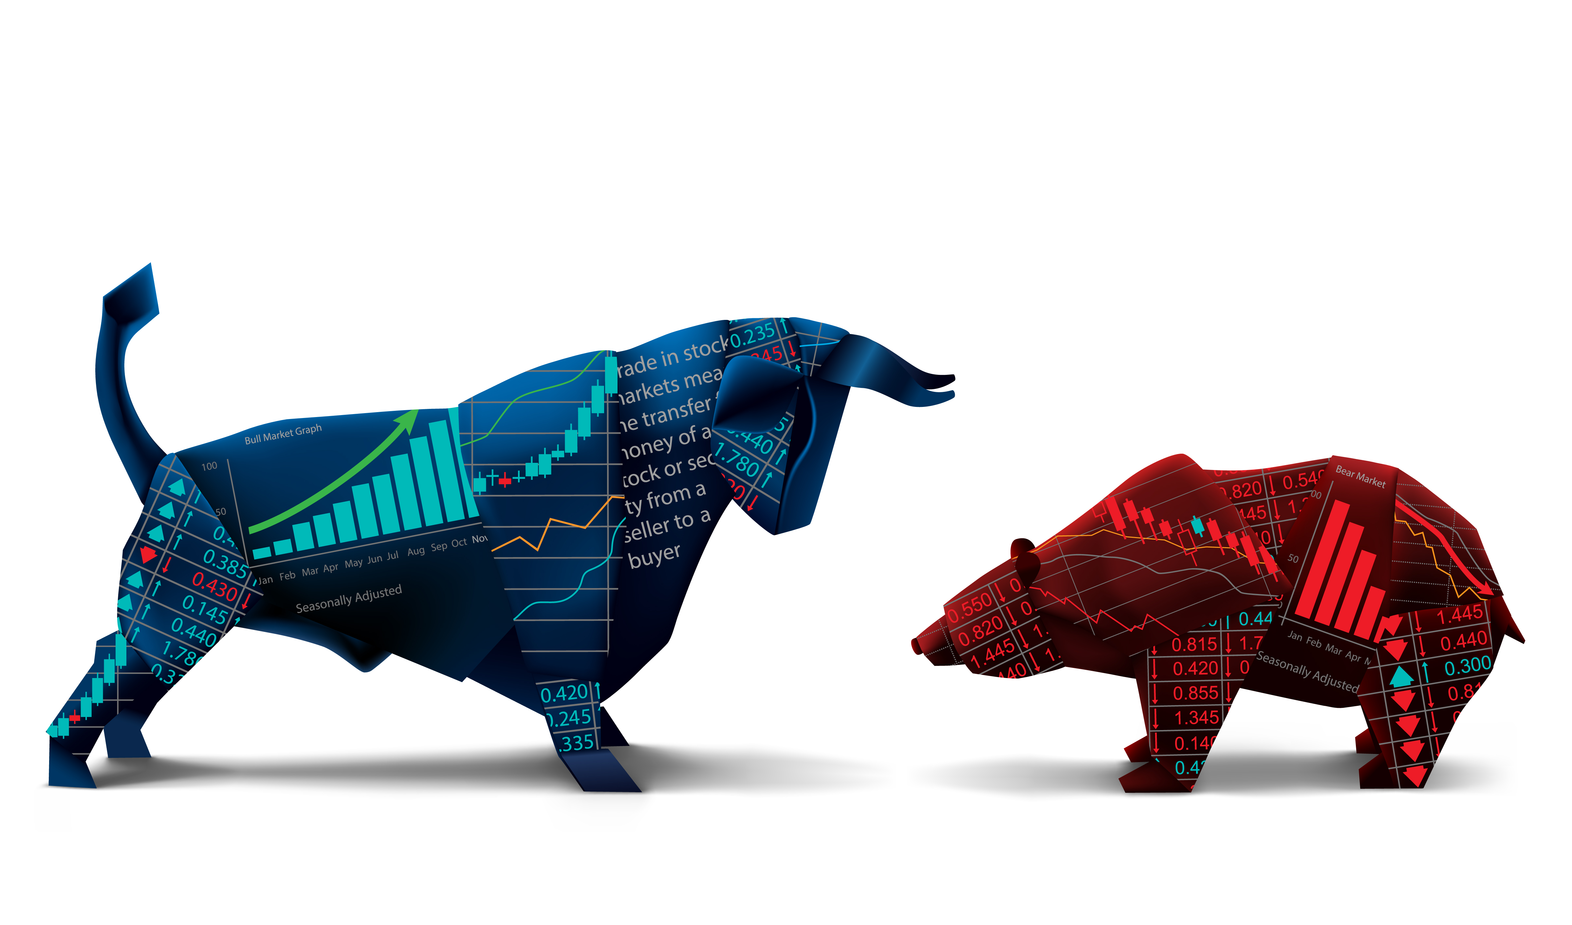
Number of Bullish and Bearish Tweets per day

Slide 14
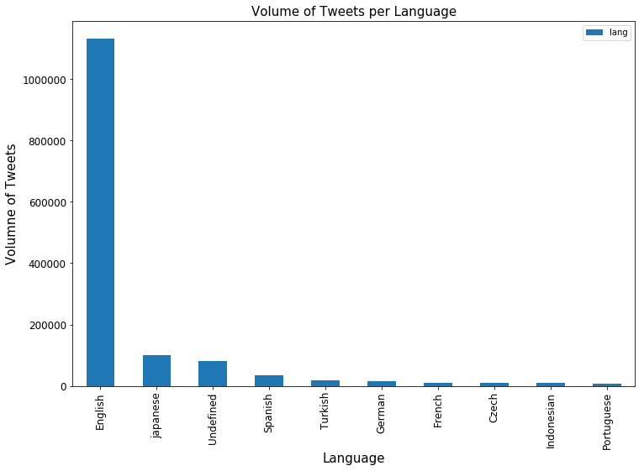
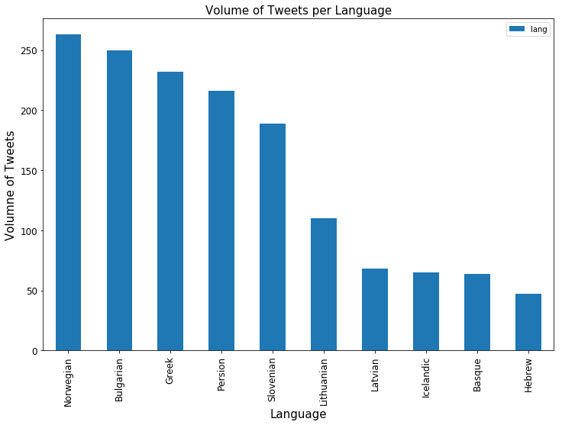
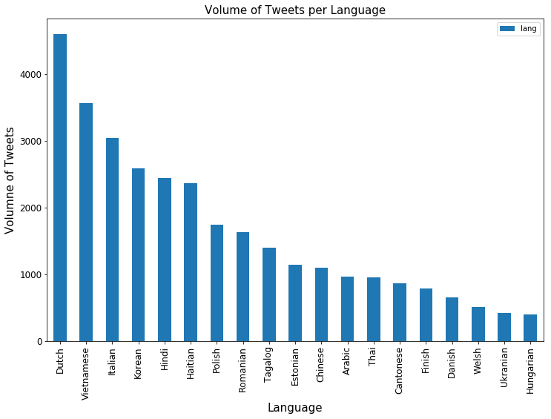
Tweet count by unique language

Slide 15
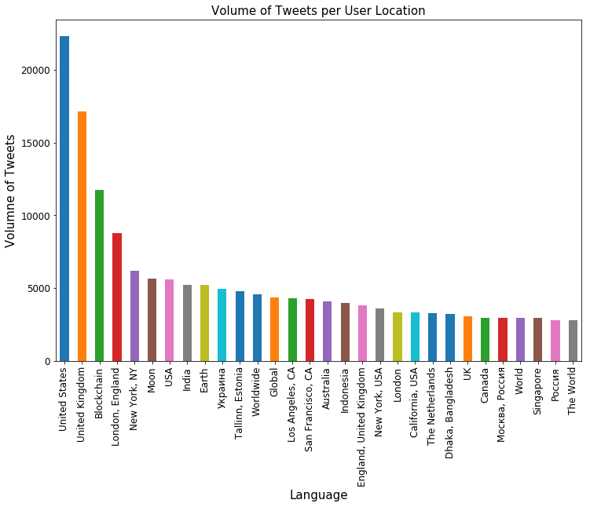
Tweet count by unique user defined location

Slide 16
cONCLUSION
Based of this study it is safe to say there is no correlation between Twitter sentiment and Bitcoin price at the intra-day level.
Twitter sentiment is not a short term driver of Bitcoin.
We can also say there is no correlation between tweet volume and Bitcoin price.
Tweet volume is not a good driver of Bitcoin.
We can say there is an inverse weak correlation between Twitter sentiment and Bitcoin price at the inter-day level.
This could be due to the short range of data used.
We can say there is no correlation between Twitter volume and Bitcoin price at the inter-day level.
This could also be due to the short range of data used.
We also observed from the user language count and user location count that Twitter is a bit unreliable to work with.
Recommendations:
If I were to continue this study I would take a wider range of dates.
I would try to isolate a Bitcoin financial community and see who the drivers of that community are.
I would specifically study this community instead of the entire Twitter community.

